Slide 1
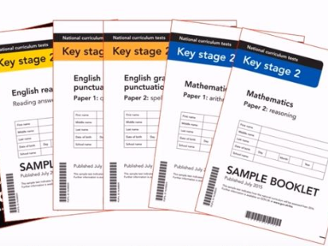
Year 5/6 Curriculum: A Guide for Parents
This guide is designed to provide information for parents and carers about the end of year expectations and an overview of the National Curriculum alongside the school-based curriculum.
Curriculum overview:
At BJA we run a 4 year rolling programme of topics (shown below) Some children may start in year 3 in year C, but will cover all topics during their time at BJA.
Year A | Year B | Year C | Year D
Under the sea | To infinity and beyond! | Branston at War | Walk like an Egyptian
Chocolate | Extinction! | British Settlers | Eco Warriors
Extreme Earth | Inventors | Rainforests | The Olympics
KS2 SATs:
In year 6, all children (except in exceptional circumstances) will sit the KS2 SATs over four days in May. The structure of these tests are as follows:
SPaG (1x 45 minute test)+ (1x spelling test- consisting of 20 words)
Maths (1 x 30 min arithmetic paper) (2x 40 minute reasoning papers)
Reading (1 x 60 minute paper)
Children will also receive a teacher assessed level for their Writing.
Meetings will be held prior to the tests to provide further information for parents. At BJA we prefer to focus on the overall learning, instead of the test in isolation. We offer support both for learning needs in terms of booster session, but also emotional support and stress-management support as needed (please contact us if you feel your child would benefit from this.)

Slide 2
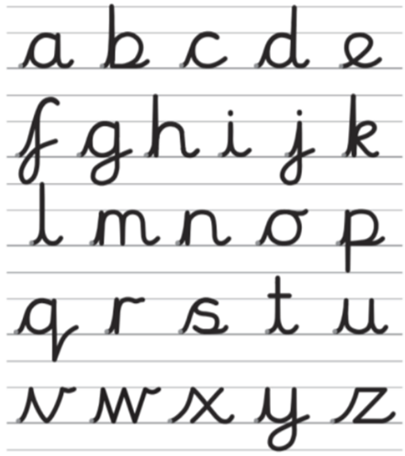
Writing: End of year expectations:
Year 5 | Year 6
Add phrases to make sentences more precise and detailed. Use range of sentence openers – judging the impact or effect needed. Begin to adapt sentence structure to text type. Use pronouns to avoid repetition. Indicate degrees of possibility using adverbs (e.g. perhaps, surely) or modal verbs (e.g. might, should, will). Use the following to indicate parenthesis: brackets dashes comma Use commas to clarify meaning or avoid ambiguity. Link clauses in sentences using a range of subordinating and coordinating conjunctions. Use verb phrases to create subtle differences (e.g. she began to run). Consistently organize into paragraphs. Link ideas across paragraphs using adverbials of time (e.g. later), place (e.g. nearby) and number (e.g. secondly). Write legibly, fluently and with increasing speed. | Use subordinate clauses to write complex sentences. Use passive voice where appropriate. Use expanded noun phrases to convey complicated information concisely (e.g. The fact that it was raining meant the end of sports day). Use a sentence structure and layout matched to requirements of text type. Use semi-colon, colon or dash to mark the boundary between independent clauses. Use colon to introduce a list and semi colon within a list. Use correct punctuation of bullet points. Use hyphens to avoid ambiguity. Use full range of punctuation matched to requirements of text type. Use wide range of devices to build cohesion within and across paragraphs. Use paragraphs to signal change in time, scene, action, mood or person. Write legibly, fluently and with increasing speed.
Handwriting: These are the letter formations we encourage:

Slide 3
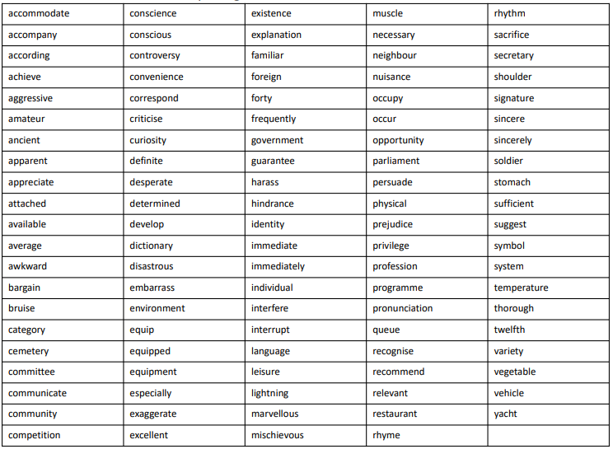
Spelling list for Year 5/6: (Children may also review the Year 1/2 and Year 3/4list)
Reading: End of year expectations:
Year 5 | Year 6
Summarise main points of an argument or discussion within their reading and make up own mind about issue/s. Compare between two texts Appreciate that people use bias in persuasive writing. Appreciate how two people may have a different view on the same event. Draw inferences and justify with evidence from the text. Vary voice for direct or indirect speech. Recognise clauses within sentences. Explain how and why a writer has used clauses to add information to a sentence. Use more than one source when carrying out research. Create a set of notes to summarise what has been read. | Refer to text to support opinions and predictions. Give a view about choice of vocabulary, structure, etc. Distinguish between fact and opinion. Appreciate how a set of sentences has been arranged to create maximum effect. Recognise: complex sentences with more than one subordinate clause phrases which add detail to sentences Explain how a writer has used sentences to create particular effects. Skim and scan to aide note-taking.

Slide 4
Maths: End of year expectations:
Year 5 | Year 6
Count forwards and backward with positive and negative numbers through zero. Count forwards/backwards in steps of powers of 10 for any given number up to 1,000,000. Compare and order numbers up to 1,000,000. Compare and order numbers with 3 decimal places. Read Roman numerals to 1,000. Identify all multiples and factors, including finding all factor pairs. Use known tables to derive other number facts. Recall prime numbers up to 19. Recognise and use square numbers and cube numbers. Recognise place value of any number up to 1,000,000. Round any number up to 1,000,000 to the nearest 10, 100, 1000, 10,000 or 100,000. Round decimals with 2 decimal places to nearest whole number and 1 decimal place. Add and subtract numbers with more than 4-digits using formal written method. Use rounding to check answers. Multiply 4-digits by 1-digit/ 2-digit Divide up to 4-digits by 1-digit Multiply & divide whole numbers & decimals by 10, 100 and 1,000 Recognise and use thousandths. Recognise mixed numbers and improper fractions and convert from one to another. Multiply proper fractions and mixed numbers by whole numbers. Identify and write equivalent fractions. Solve time problems using timetables and converting between different units of time. | Use negative numbers in context and calculate intervals across zero. Compare and order numbers up to 10,000,000. Identify common factors, common multiples and prime numbers. Round any whole number to a required degree of accuracy. Identify the value of each digit to 3 decimal places. Use knowledge of order of operations to carry out calculations involving four operations. Multiply 4-digit by 2-digit Divide 4-digit by 2-digit Add and subtract fractions with different denominators and mixed numbers. Multiply simple pairs of proper fractions, writing the answer in the simplest form. Divide proper fractions by whole numbers. Calculate percentage of whole number.
Maths: Times tables:
Times tables remains a key element for success in the Maths Curriculum. We will continue to review and focus on improving the rapid recall of all times tables up to 12x12 and build on from the Year 4 Multiplication check. You can help a great deal with this at home. Particularly through the use of games, songs and quick fire recall practice. (There are lots of hints and tips on our school website.)
All children will be provided with a Times Tables Rockstar's login. We also promote the timestables.co.uk website.

Slide 5
Science: End of year expectations:
 | Year 5 | Year 6
Planning an investigation | Ask questions and offers own ideas for scientific enquiry. Using prompts can plan a suitable series of steps in an investigation. May need support in clarifying the question, to suit a scientific purpose. Selects equipment from a range offered (including digital). Considers the degree of accuracy required when measuring. | Asks detailed questions and offers an accurately framed question, for a scientific enquiry. Can independently plan a suitable series of steps in a fill investigation. Selects equipment from a range offered (including digital). Takes into account the degree of accuracy required when measuring.
Fair Testing | Knows when to answer a question through a fair test, or when to use observation or data collection from another source. | Sets up a fair test. Considers whether plans will give enough evidence to come to a trustworthy conclusion.
Prediction | Can make a prediction of a possible outcome, can offer a reason based on specific scientific understanding of observation. | Can make a detailed prediction based on scientific concepts, and is able to represent it as a graph or description of a pattern.
Safety | Can suggest a series of safety measures, following the pattern of the investigation. | Can present a series of safety measures, outlining scientific good practice.
Collecting evidence | Makes a series of relevant observations. Takes accurate readings on measuring equipment, repeating them when necessary. Creates own tables and graphs, based on average readings. | Makes a series of relevant structured observations. Takes accurate readings on a range of measuring equipment, repeating them when necessary. Chooses most suitable method for showing data, including different scales.
Results and conclusions | With support, identifies linking factors to generate a 'rule'. Supports these with specific evidence, sometimes relating to scientific knowledge. Can discuss how trustworthy their findings are. | Established 'rule' and possible exceptions. Relates patterns to scientific knowledge. Can give reasons why other enquires may offer different results.

